Slide 1
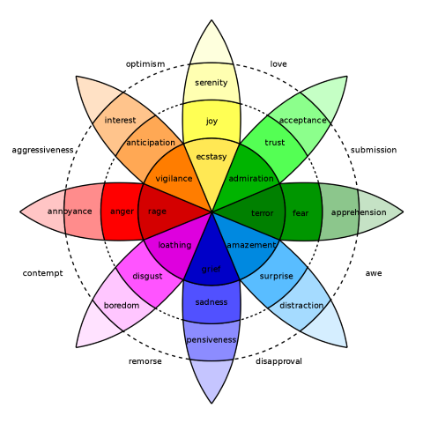
Cortext: A Machine Learning System For Emotion Recognition and Mood Detection from Text
Realized by Abouhane Zahra
Bazgour Yassine
Supervised by Dr. Hajar Moussanif
Evaluated by Dr. Hajar Moussanif
Dr. Chadi Mohammed Amine
January 2025
This template has been created by Slidesgo

Slide 2


Outline
Introduction
Model Architecture
Cortext
Test and Evaluation
Limitations
Perspective
Conclusion

Slide 3


Introduction

Slide 4




Introduction

Slide 5







Introduction

Slide 6


Model Architecture

Slide 7

Model Architecture
Training data (16000 row)
Validation data (2000 row)
Testing data (2000 row)

Slide 8

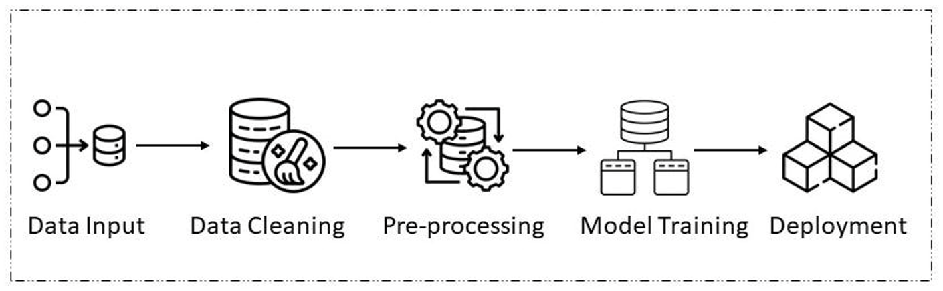
Model Architecture

Slide 9
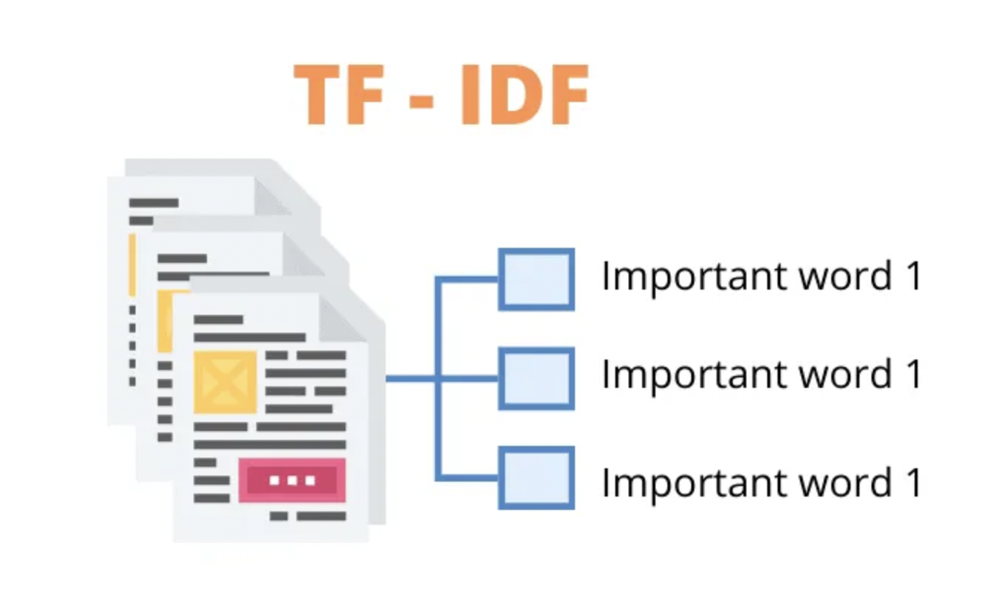
Model Architecture

Slide 10
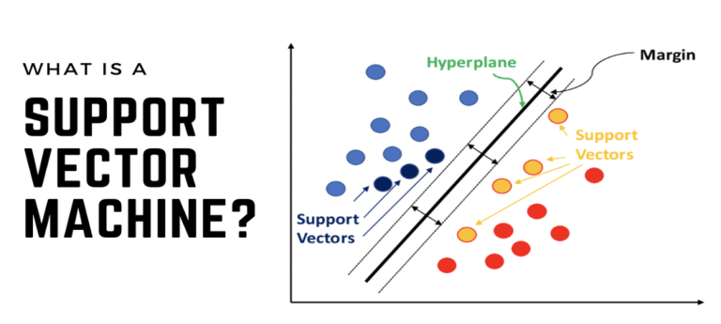
Model Architecture

Slide 11


Model Architecture
GridSearch

Slide 12

Model Architecture
Cortext.pkl

Slide 13


Cortext Interface
Accessible
Friendly User

Slide 14
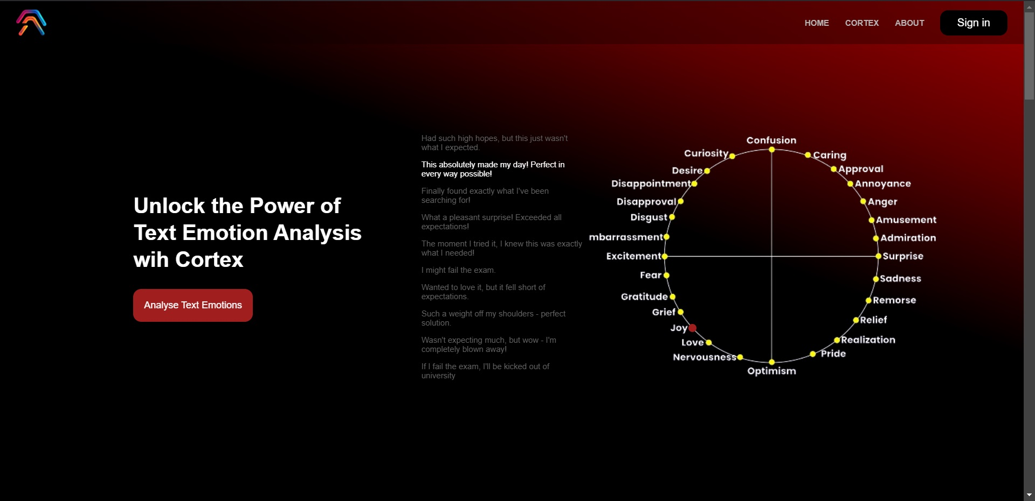
Cortext Interface

Slide 15
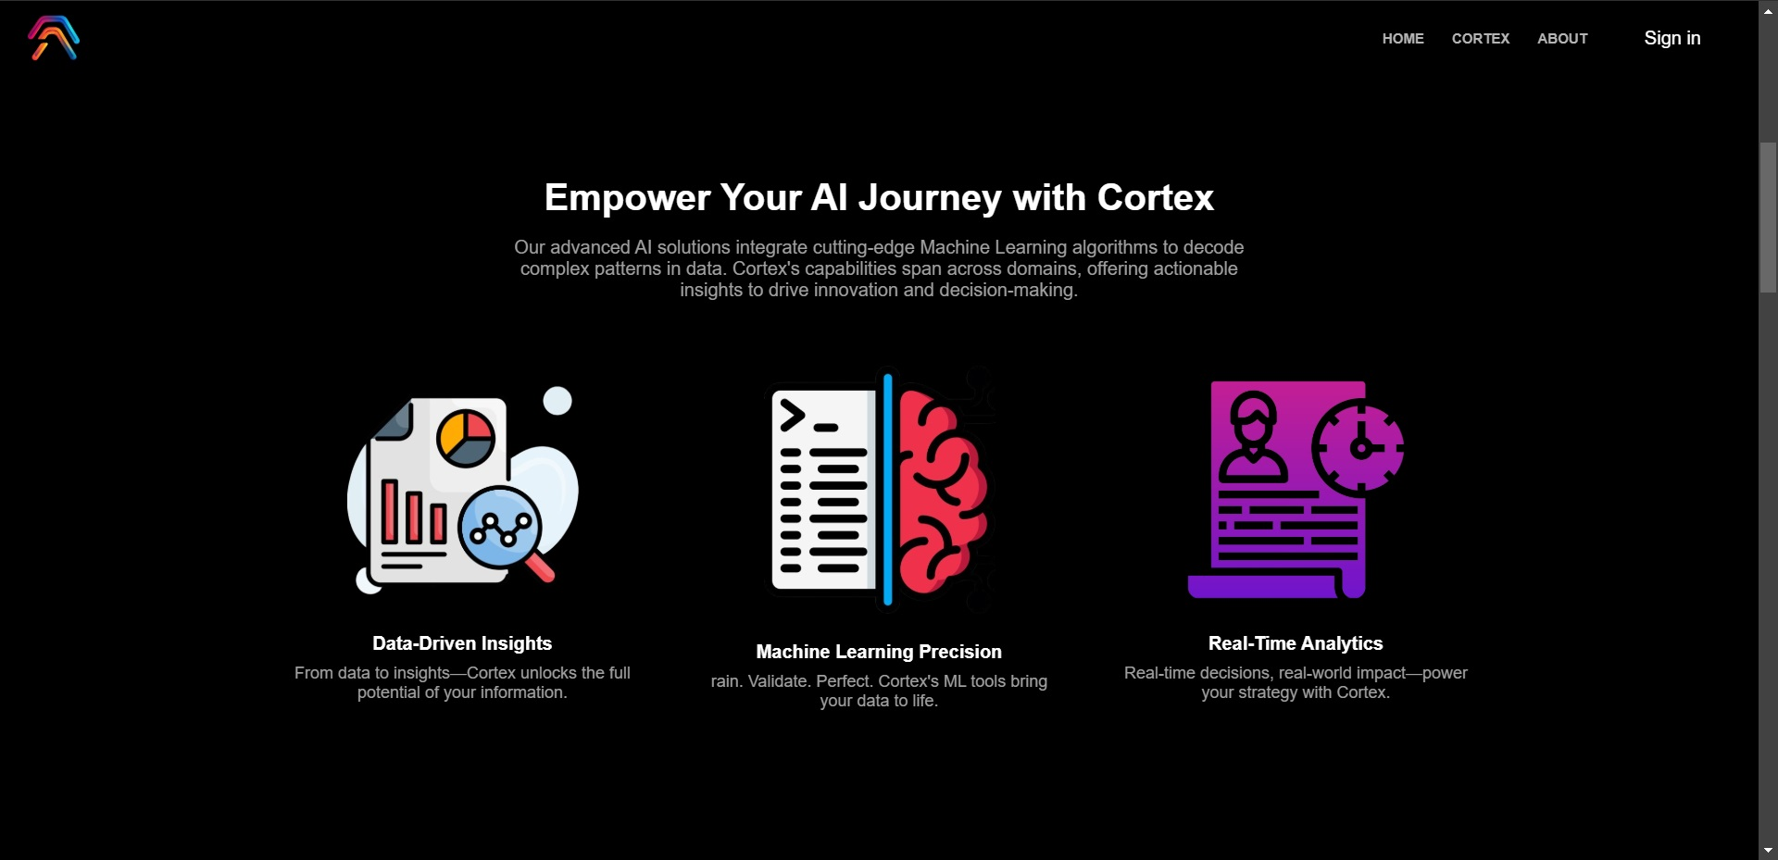
Cortext Interface

Slide 16
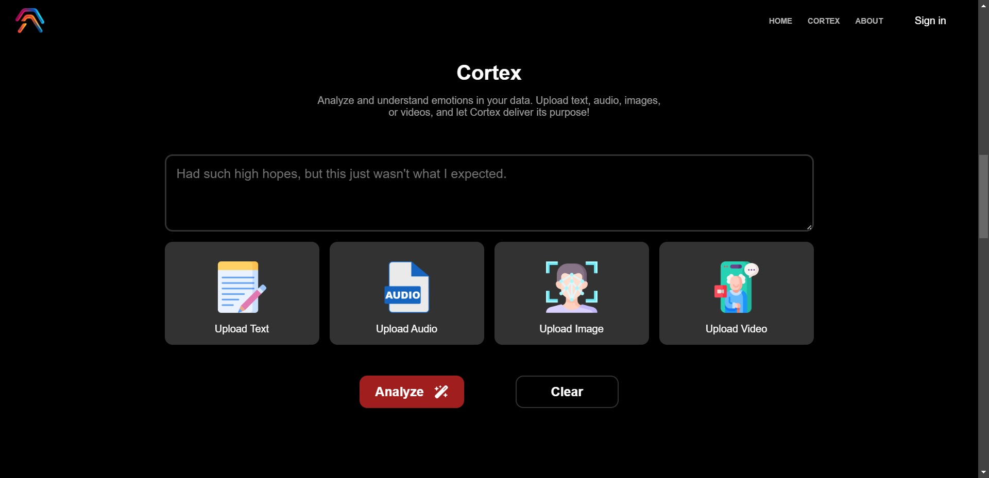
Cortext Interface

Slide 17

Cortext Interface

Slide 18
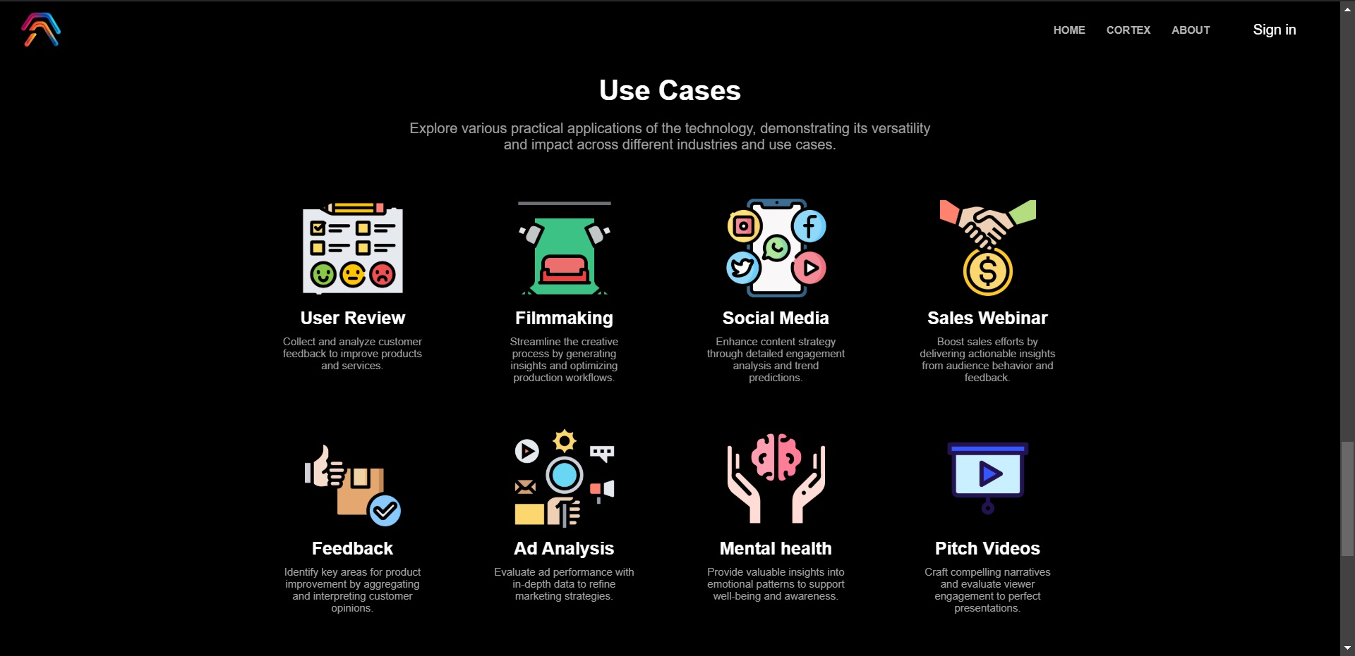
Cortext Interface

Slide 19


Test and Evaluation

Slide 20
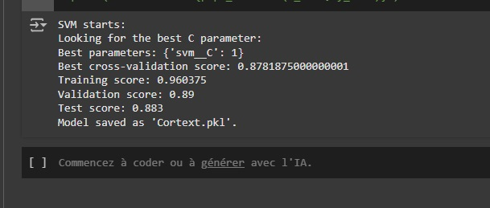
Test and Evaluation

Slide 21
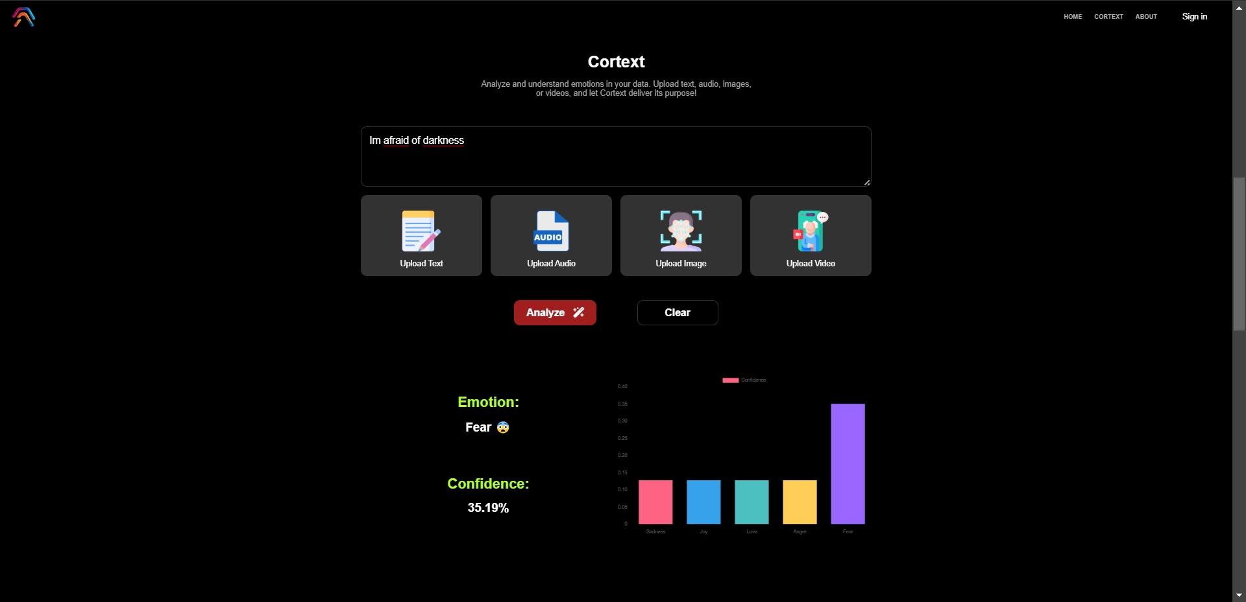
Test and Evaluation

Slide 22
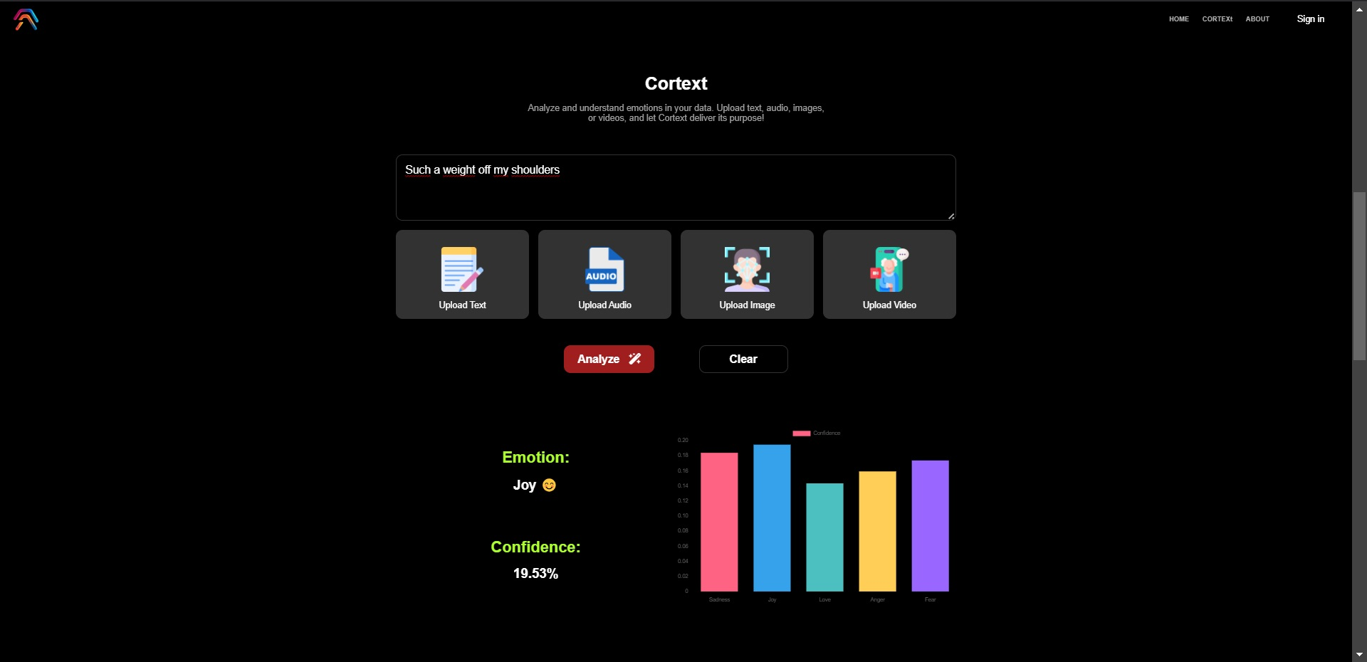
Test and Evaluation

Slide 23
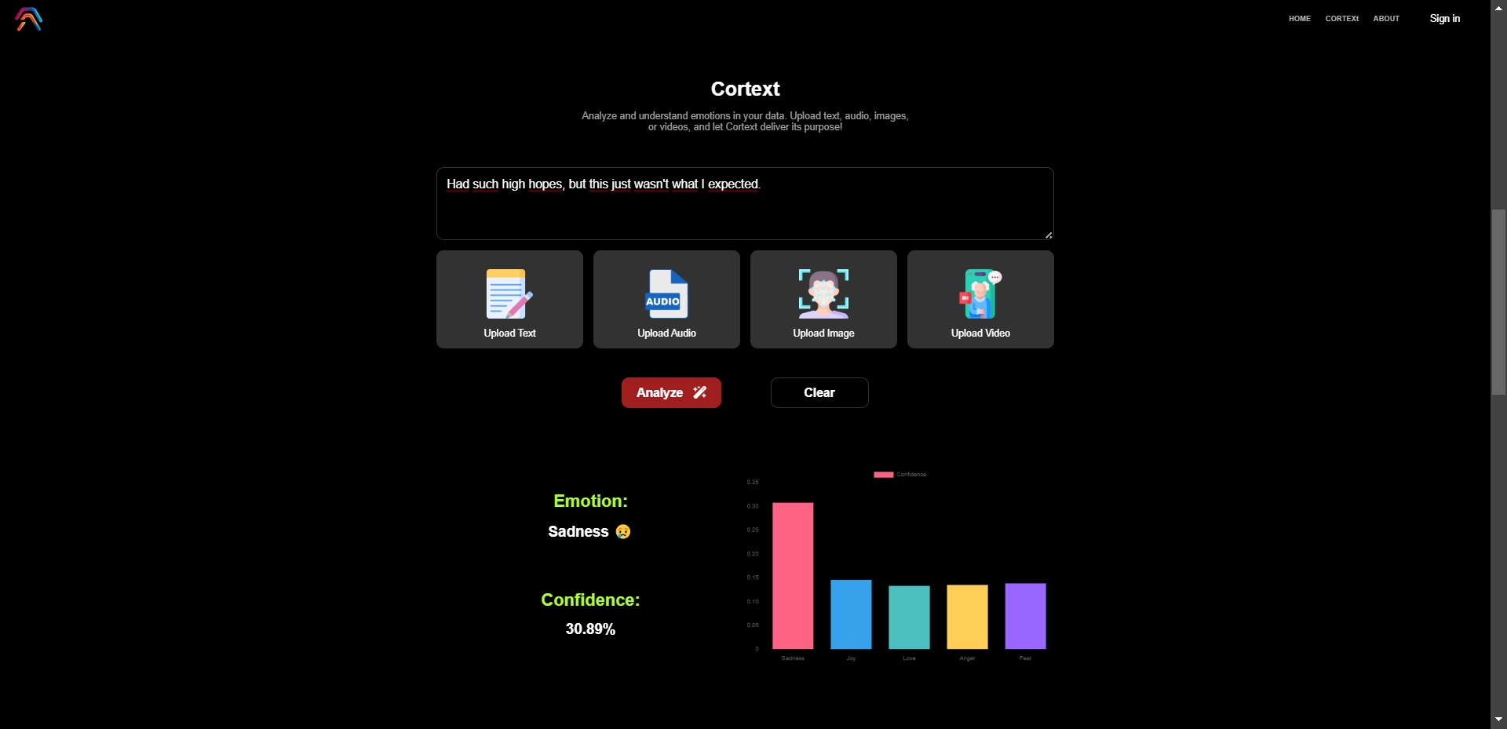
Test and Evaluation

Slide 24

Test and Evaluation

Slide 25

Test and Evaluation

Slide 26
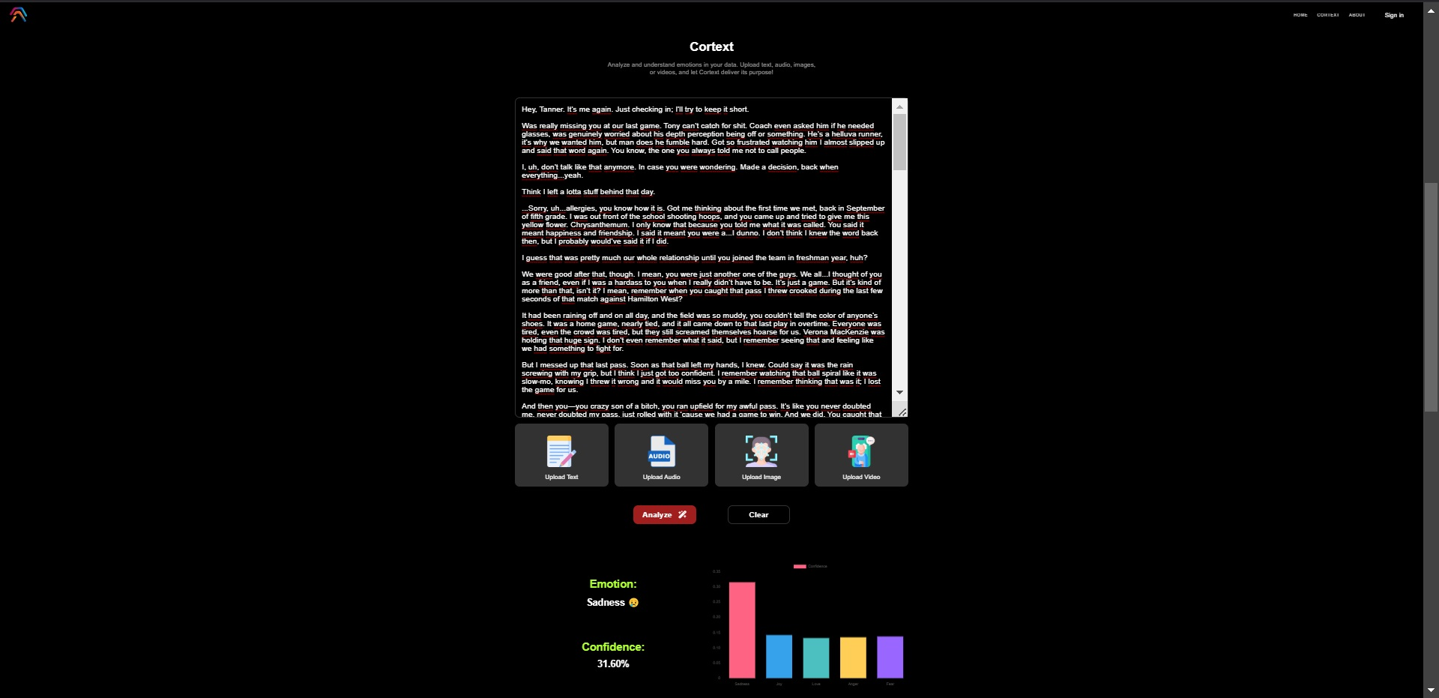
Test and Evaluation

Slide 27


Demonstration

Slide 28



Limitations
Computational Issues
Language Ambiguities
Handling Noisy Data

Slide 29



Perspectives
Data Expansion
Integrating Different Training Data Type
Expand Analysis to Cover Images and Videos

Slide 30


Conclusion

Slide 31

Thank You For Your Attention

